Slide 1

ROAD ACCIDENT DETECTION AND
ALERT SYSTEM
Using sensors and IOT for Real-Time Response

Slide 2
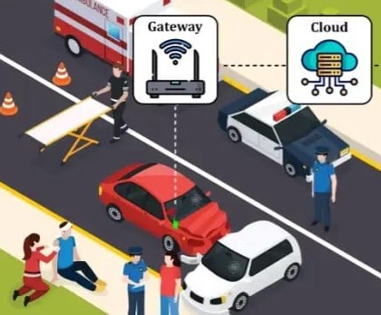
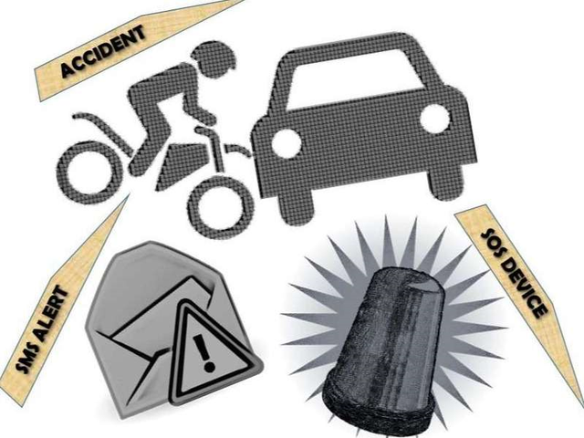
ABOUT OUR
PROJECT
This detailed presentation otlines a system using an android app and GPS to detect accidents and alert emergency services
This is automatically detects accidents and notifies emergency services by using sensors (like accelerometers)

Slide 3

ADVANTAGES OF ALERT SYSTEMS
Systems like medical alert provide with access to help in case of falls or other health incidents,potentially saving lives.ore
1
FASTER EMERGENCY RESPONSE
Accurate Location Tracking is the process of precisely identifying the real-time geographic position of a vehicle using GPS (Global Positioning System) or other location technologies.
2
ACCURATE LOCATION TRACKING
Improved Traffic Management refers to the ability to monitor, control, and optimize traffic flow more efficiently—especially during or after road accidents—by using real-time data and alerts.
3
IMPROVED TRAFFIC MANAGEMENT

Slide 4
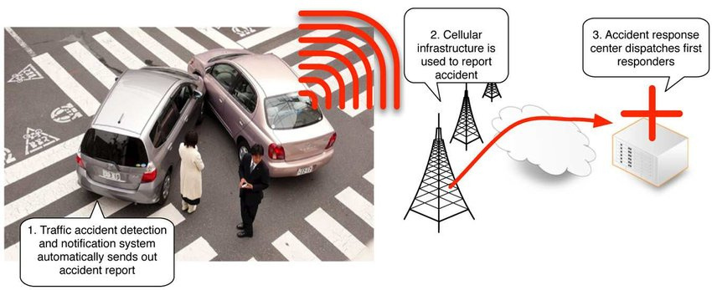
KEY COMPONENTS
Sensors & Accelerometers
GPS Modules
Communication Modules
Deep learning & AI
IOT Integration

Slide 5

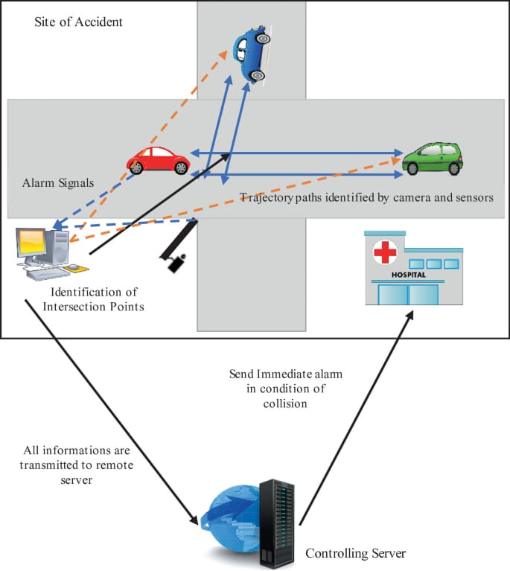
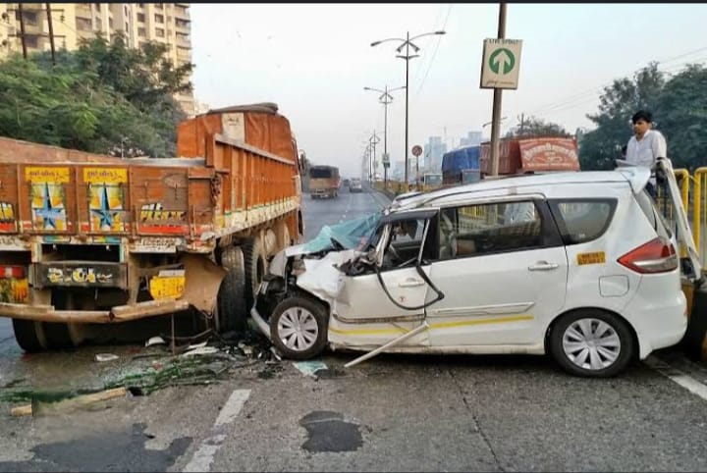
HISTORY
The rapid growth of technology and infrastructure has made our lives easier.The advent of technology has also increased the traffic hasrds adn the road take place frequently which causes huge loose of life and property becaue of the poor emergency facilities.

Slide 6

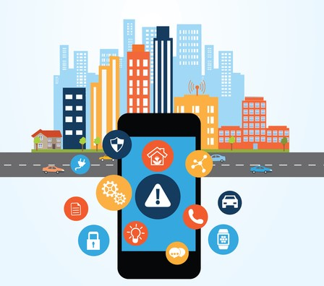
OUR FUTURE
DEVELOPMENT
OF ALERT SYSTEM
The future development of road accident alert systems refers to the advancement and integration of new technologies such as Artificial Intelligence (AI), Internet of Things (IoT.
Health monitoring sensors
Satellite-Based Connectivity
Voice Assistant Integration
Integration With Smart Traffic Signals
Drone Assistance
Wearable Device Support
These developments aim to make the system more intelligent, reliable, and efficient by predicting accidents,

Slide 7
OUR ALERT SYSTEM
No accident goes unnoticed.
1
VISION
Our vision is to create a smart, reliable, and real-time accident detection and alert system that ensures faster emergency response, reduces fatalities, and improves road safety
Response time is minimized, saving more lives.
2
By integrating IoT, GPS, sensors, AI, and communication technologies, the system will automatically detect accidents, analyze severity, and instantly alert emergency services, nearby hospitals, and family members.
Drivers, passengers, and pedestrians feel safer on roads.
3

Slide 8
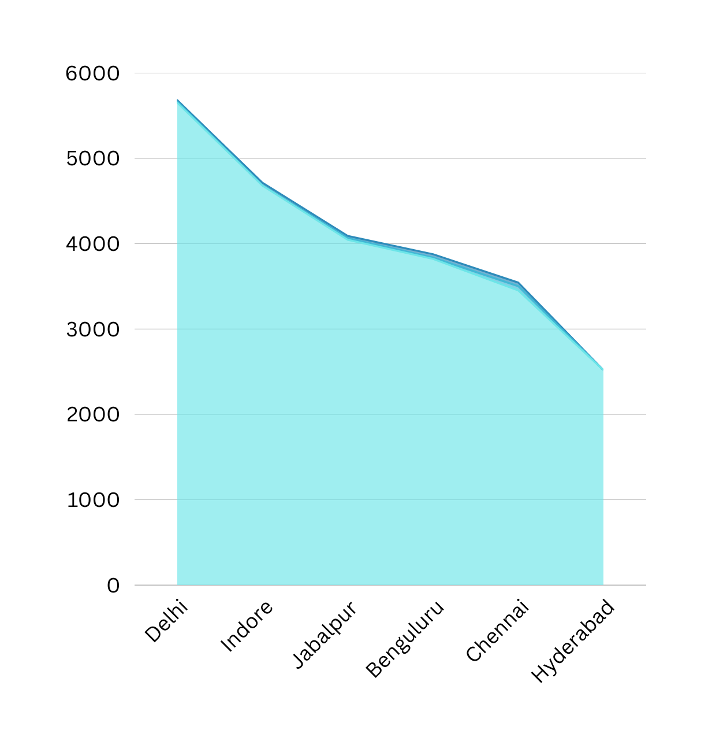

ACCIDENTS IN 2022
Top 6 cities in terms of accidents

Slide 9





TEAM MEMBERS
CH.TANUJA
P.SNEHITA
REDDY
M.APARNA
G.UMAMAHESWARI

Slide 10

THANK YOU

